Slide 1
Sugar Labs: Calculate Activity
Aaron Gaynor, Jacob Hennessy, Aaron Walton, Sabrina Yongue

Slide 2
The Open Source Project
Sugar Labs is an open source Linux based operating system designed as a desktop interface, and includes activities that the user can use to learn
An activity is an app on the desktop that requires active engagement from the learner
Activity results are saved to a journal for users to review later and can also be shared with other users to support real time collaboration
We chose to specifically test the Calculate Activity inside of Sugar Labs

Slide 3
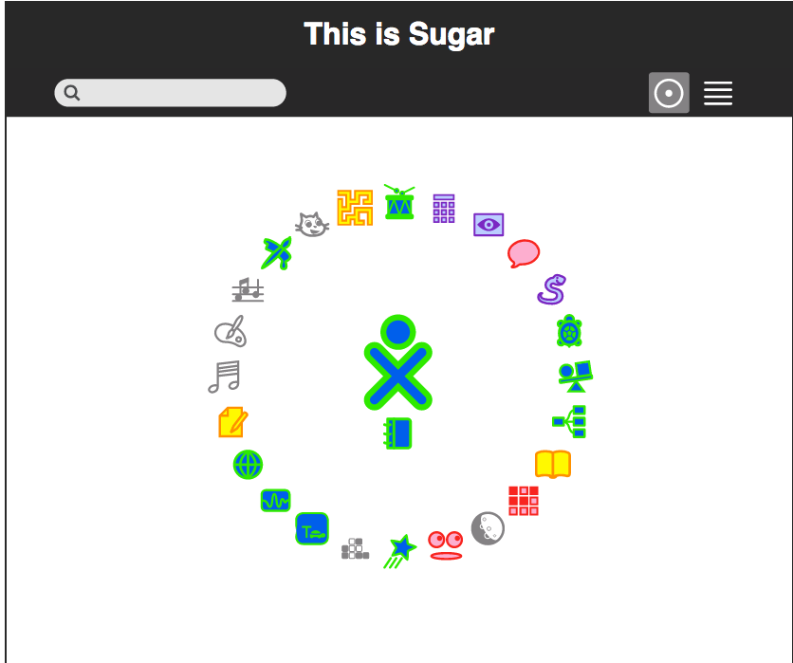
Sugar Labs Image
Created to teach kids to use computers and facilitate in other learning
Has a simple and minimalistic gui

Slide 4
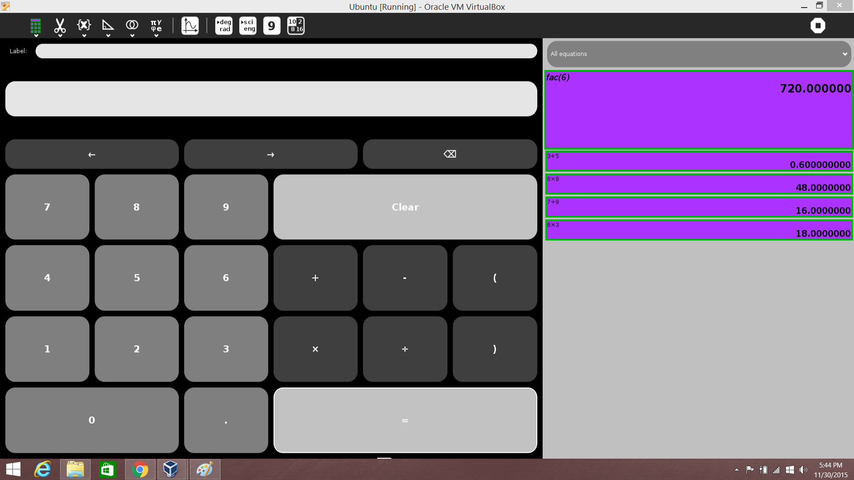
The Calculate Activity
GUI based calculator
Written in python
Functions are housed in python files labeled ‘functions.py’ and ‘rational.py’

Slide 5
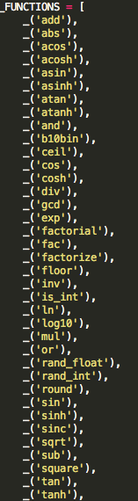
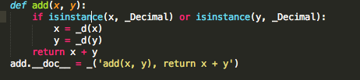
Calculator Functions
The image to the right is just a snippet of all the individual functions that were possible to test
We chose to test some of the more simple ones:
add, subtract, factorial, division, and multiplication
Below is an image of what the add function does

Slide 6
Isolating the Functions.py File
(Hard Times in the Neighbourhood)
One of the problems we had with testing Sugar Labs was creating a testing framework that ran in Linux and interacted with the Sugar Labs OS
We initially began by trying to directly contact the Sugar Labs activity Calculate without running it in the OS
Due to its dependencies, this was impossible because the file paths were written with the assumption that the Sugar Labs OS was running the code
After many hours of digging on the web, all we could find was testing frameworks written in Sugar Labs to run in Sugar Labs
Eventually we gave up on Sugar Labs and began to try pybiblio

Slide 7
The Failed Branch
We spent a small amount of time working with pybiblio in our exhaustive quest to find an open source project upon which to work
During this, we attempted simply downloading pybiblio and its dependencies were numerous. It took several hours to track down all of the systems it was dependent on and install them
Once we had finally installed and gotten pybiblio running, we discovered the importance of code readability and usability, as there was no gui and the instructions on running pybiblio were scarce
We never figured out how to give the code information as we returned to our original focus project

Slide 8
Isolating the Functions.py File
(Finally, Something Useful!)
On a whim (due to frustration with the pybiblio project), one of us decided to dig through the code of the Sugar Labs Calculate Activity to see if there was a way to test its functions without running the OS
They found a file named Functions.py which only had a dependency upon one file, Rational.py
Rational.py had no dependencies, and so we attempted to remove these two files, and to our delight the functions maintained their abilities and worked
Finally, we were capable of beginning to design and implement a testing framework

Slide 9
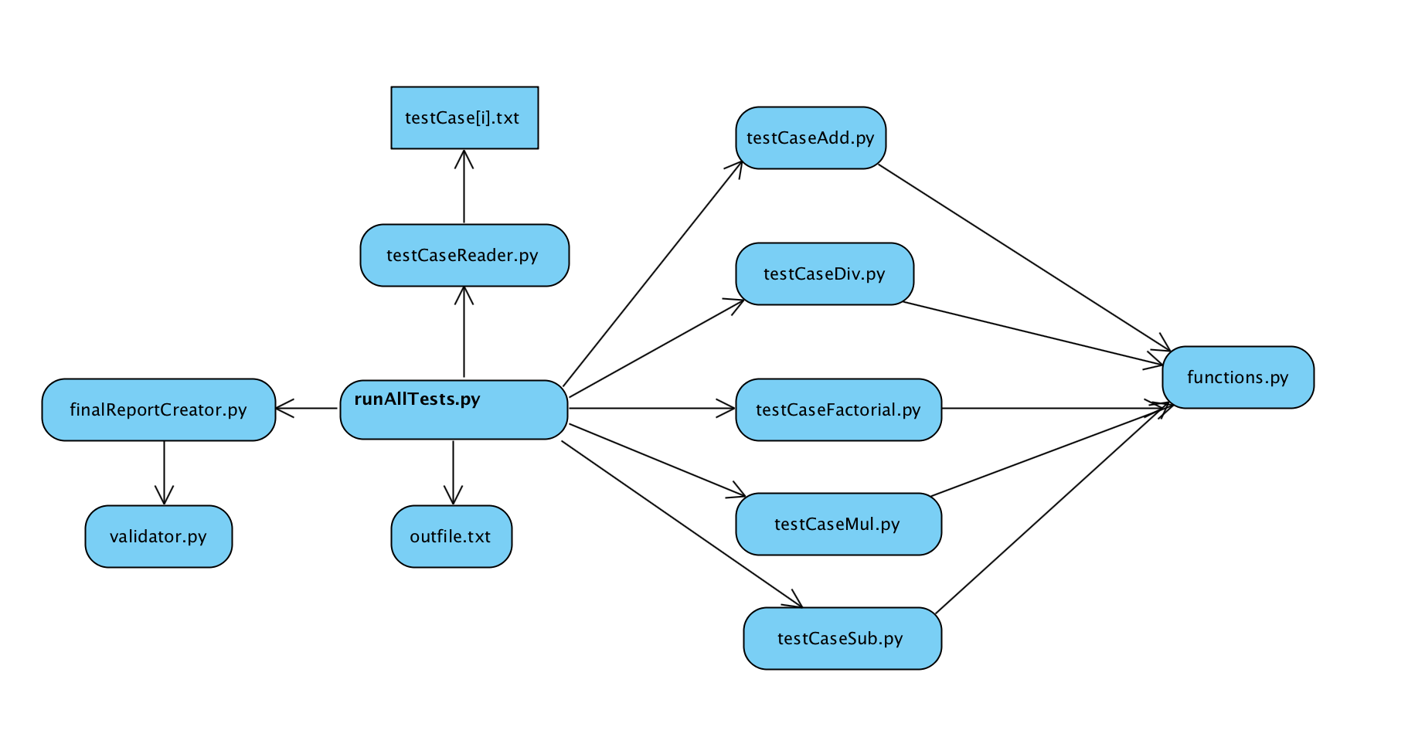
Testing Framework
Overall file structure for the testing framework

Slide 10
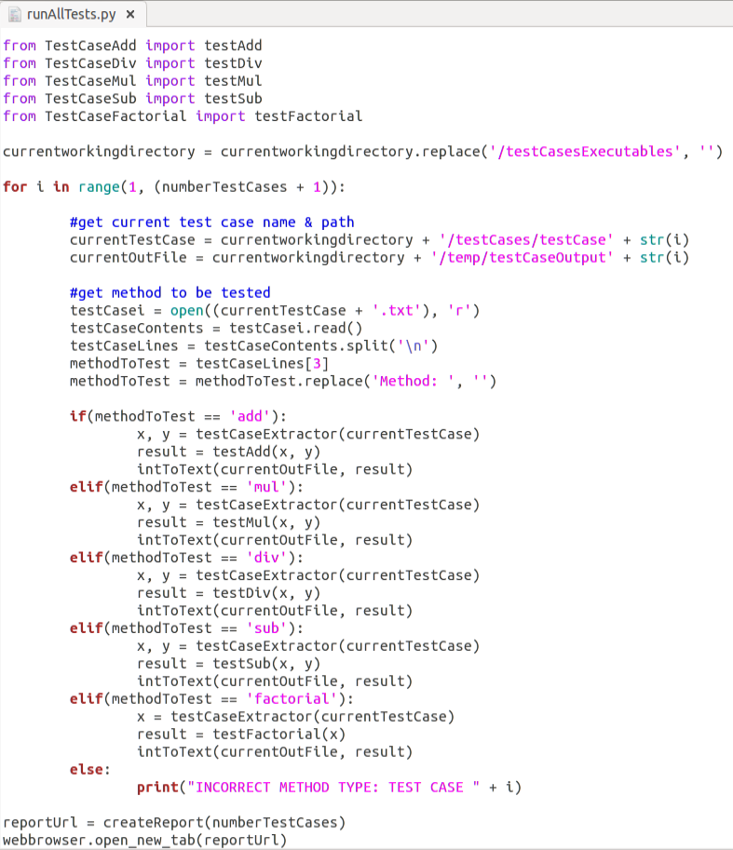
Code Example
This is the runAllTests.py file
Testing Framework works in a Master-Slave Relationship with runAllTests.py as the Master
Imports all of the TestCaseExecutables and functions.py before looping through test cases
Reads input test file
Uses input test file to select method
After calling all methods, creates and opens HTML file

Slide 11
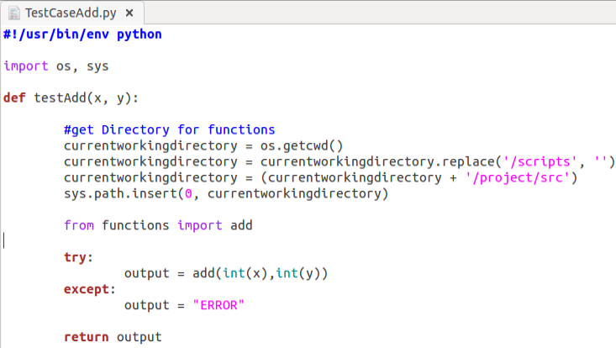
Code Examples Cont.
This is the general layout of the scripts that interact with functions.py
Creates a relative file path to the functions file
Tries to call the function, and handles errors by returning ERROR
If the function works properly, returns the function’s output

Slide 12
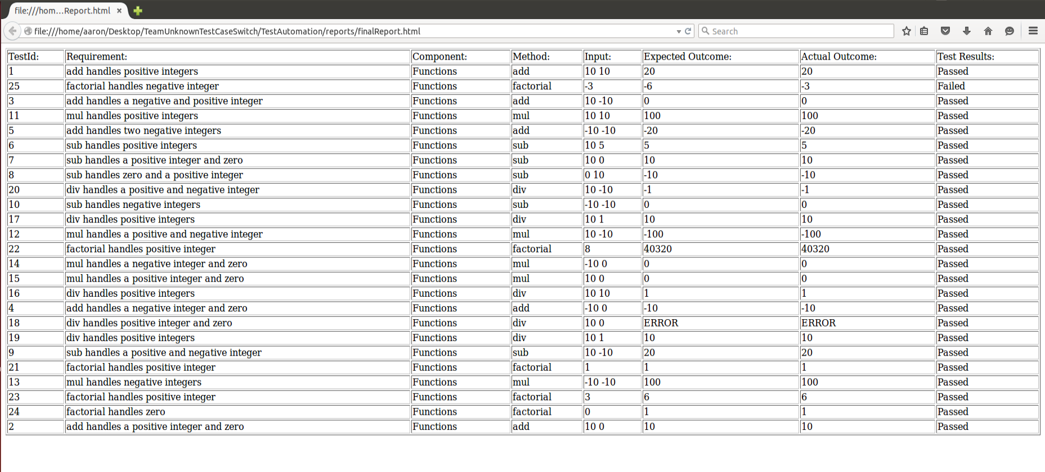
The Output

Slide 13
Fault Injection
Finding ways to inject faults that would not break all test cases reliant on the method was difficult
We injected a fault into add such that it only returns the absolute value of the addition of the inputs
We injected a fault into sub such that it subtracts x from y as opposed to y from x
We injected a fault into mul such that it multiplies x by the absolute value of y
We injected a fault into divide such that it always divides x by x as opposed to x by y
We injected a fault into factorial such that it loops past 1 and multiplies the result by 0

Slide 14
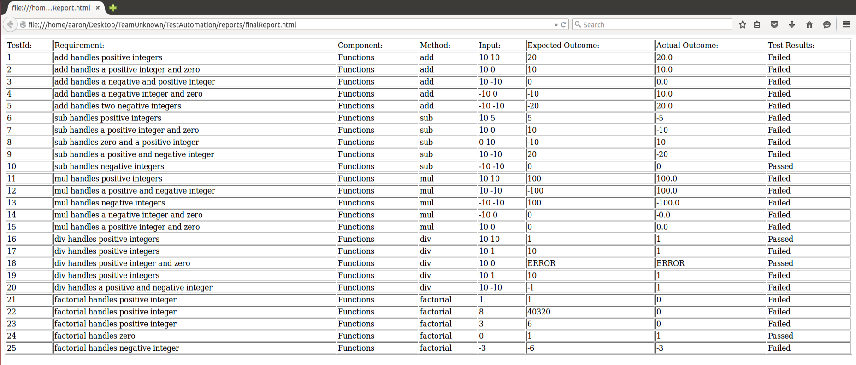
Fault Injection Output

Slide 15
Our Experiences
Project Switching
Being able to weigh the pros and cons of each project, assessing the workload, and knowing everyone’s skill set to properly decide which is right for you.
We switched from sugarlabs to pybiblio, then back to sugar labs because it was all in python and we found a function that was easy to run and compile. We also are all familiar with python, so we concluded that sugar labs was a good fit for us.
Time Management
Working Around Variable Schedules
Creating MASTERPIECES
Creating an attack plan for each meeting with objectives to be completed
Creating a list of things to be done based on importance and due date

Slide 16
Our Experiences Cont.
Problem Resolution
The important skill of being able to reassess the definition of the problem at hand, and being able to alter the specification in order to solve the problem according to requirements.
Git and GitHub Issues
Maintaining up-to-date branches and learning new services
Version Control
Weaving together the various branches of our project to keep all fixes current, and to keep the overall system intact
Ambiguous Requirements
Finding ways to handle ambiguous requirements specifications effectively and efficiently

Slide 17
Acknowledgements
Sugar Labs - https://www.sugarlabs.org/

